Slide 1
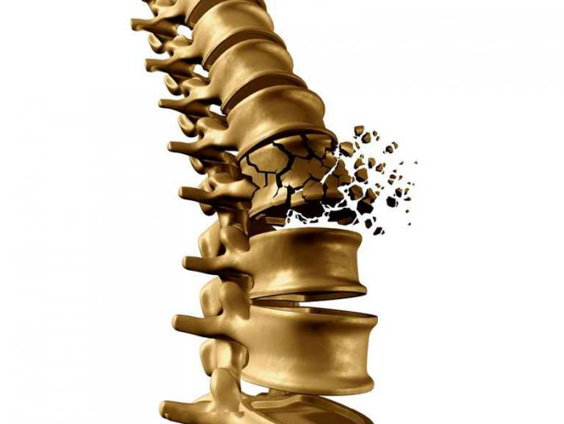
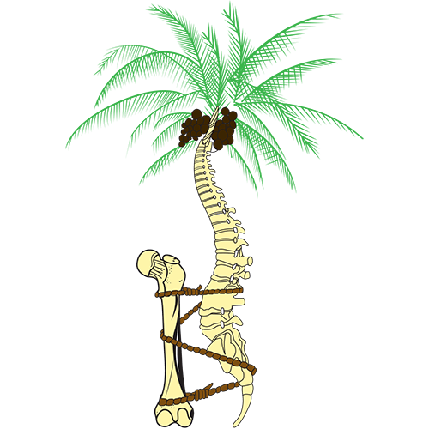
Orthopedics by: Pallavi Priya Nehru

Slide 2
Musculoskeletal system
Connective tissue, Bone, Joints,
Cranium, The Vertebral Column,
Thorax & Pelvis, and Muscles

Slide 3
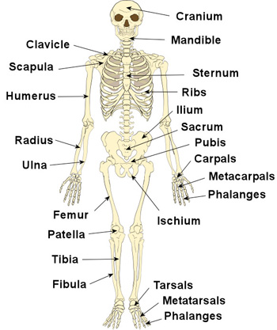
Structure of musculoskeletal system
Contain 206 bones.
It’s provides form, support, stability, and movement of the body.
The skeleton provide protection for internal organs (e.g BRAIN, HEART, LUNGS)

Slide 4
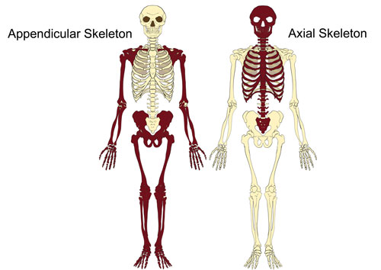
SKELETON
Skeleton can be divided into two parts
- Axial Skeleton
- Appendicular Skeleton

Slide 5
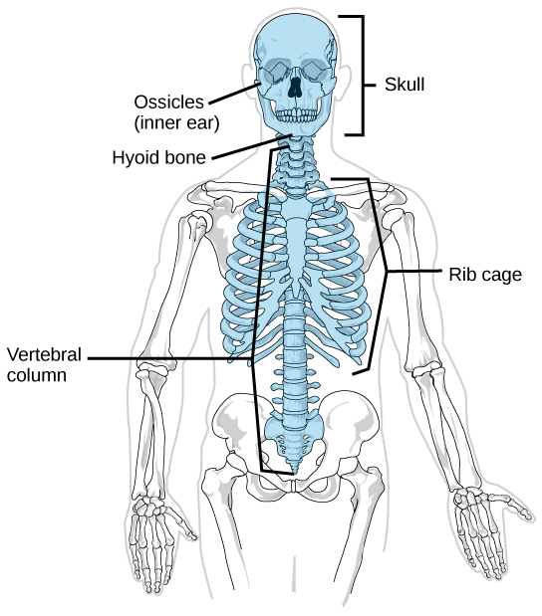
AXIAL SKELETON
Axial Skeleton- it’s a part of skeleton that consist of the bones of the head & trunk of a vertebrate.
Axial Skeleton- the 80 bones
that make up the skull, spine,
ribs, or sternum (breastbone)

Slide 6
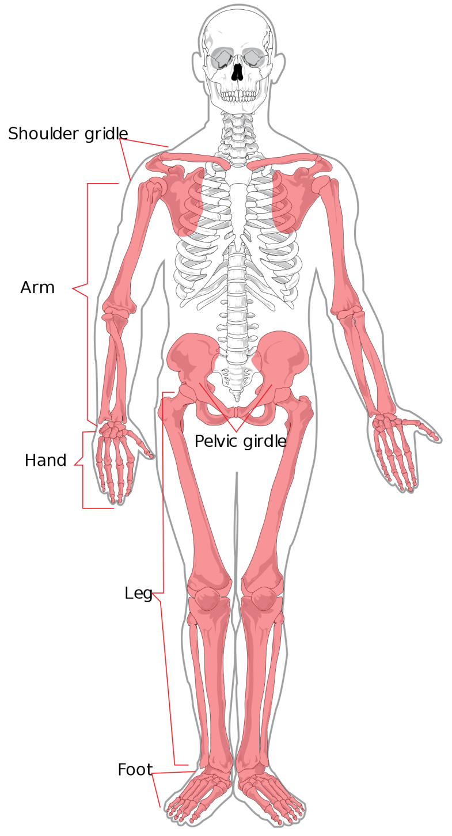
APPENDICULAR SKELETON
Appendicular skeleton- the 126
bones of the shoulder, arms,
hands, hips, legs, and feet.
Function allowing the body to
perform a wide range of motions.
pectoral girdle
upper limbs
pelvic girdle
lower limbs

Slide 7
Connective tissue
Responsible for providing maintaining form in the body.
Give mechanical support to the body.
Storage of fat and certain minerals like calcium in the bone.
types of connective tissues:-
Bone
Cartilage
Ligament
Muscle
Tendon.

Slide 8
BONE
Bone form an important component of the skeletal system.
Functions of Bones :-
Support of the body
Protection of soft organs
Movement due to attached skeletal muscles
Storage of minerals and fats
Blood cell formation

Slide 9
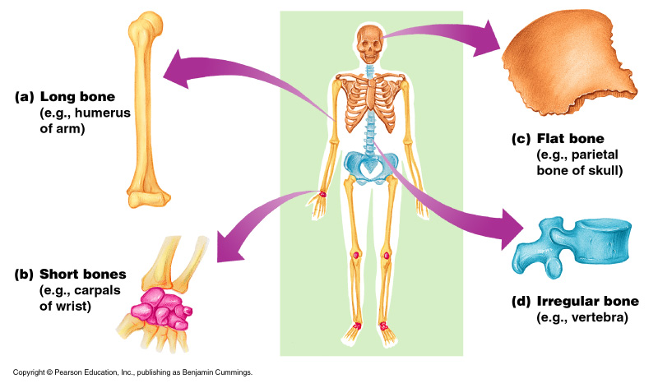
Classification of Bones on the Basis of Shape

Slide 10
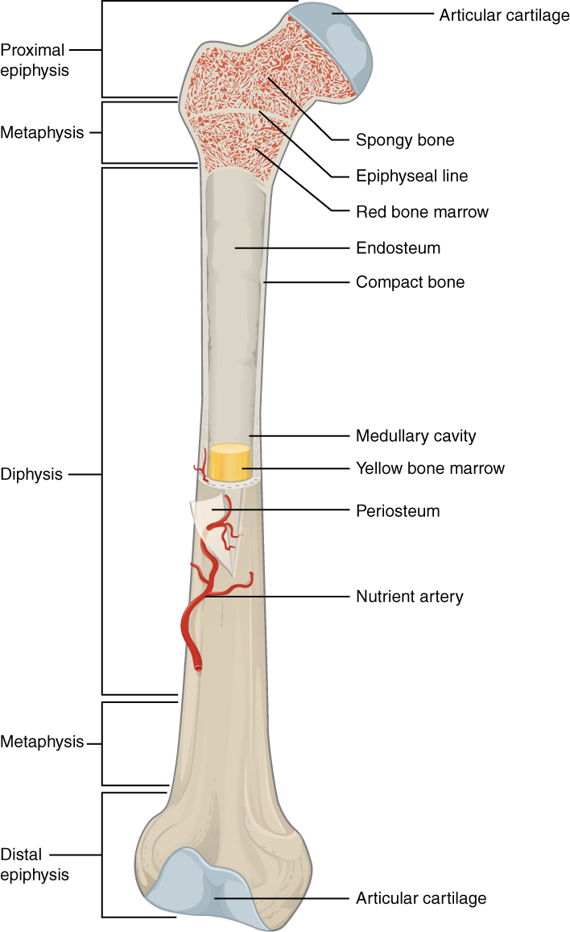
Long bone
Long- found in the arms and legs.
These bones are very strong.
Diaphysis (shaft) compact bone.
Epiphysis (ends) spongy bone.
Articular cartilage
Periosteum- Outer connective tissue
Medullary (marrow) cavity
Marrow
Yellow – fat cells
Red – RBC, WBC.
Endosteum.

Slide 11
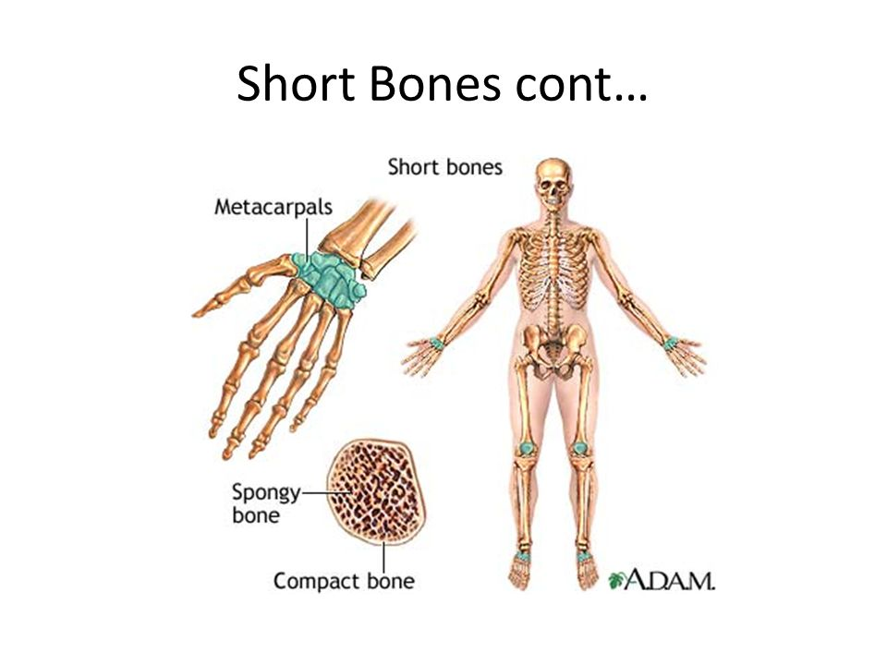
Short bones
Short bones are designated as those bones that are as wide as they are long. Their primary function is to provide support and stability with little to no movement.
Cube-shaped and
contain mostly spongy
bone.
Ex: wrists,ankles,toes.

Slide 12
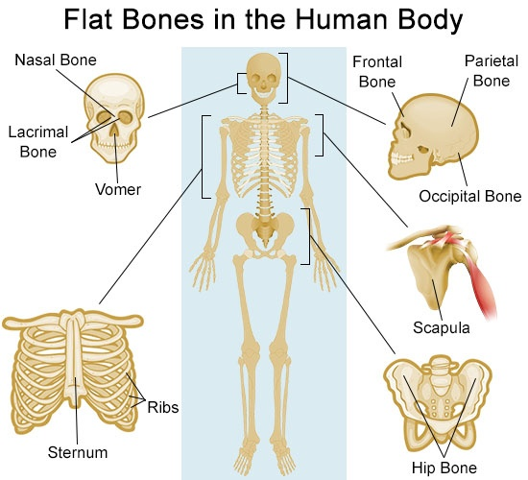
Flat bones
Flat in shape.
Provide either protection for organs and muscles.(e.g. scapula,skull bone,sternum.

Slide 13
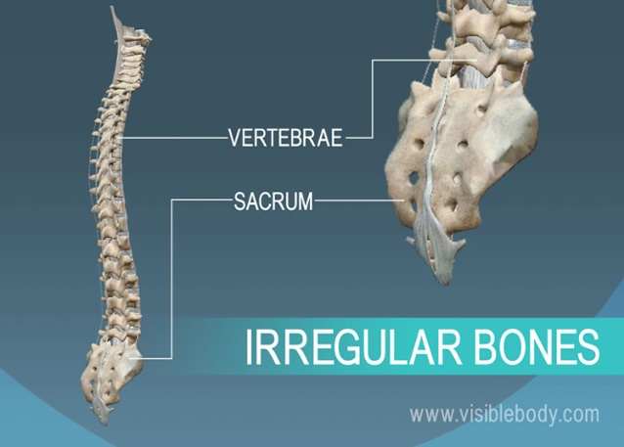
Irregular bones
Irregular bones have complicated shapes.
Irregular bones don’t fit into previous categories
(E.g. hip bone, vertebrae, hyoid bone.

Slide 14
Joints
joints, or articulation, is the place where two bones come together.
Fibrous- Immovable: connect bones, no movement. (skull and pelvis).
Cartilaginous- slightly movable, bones are attached by cartilage, a little movement (spine or ribs).
Synovial- freely movable, much more movement than cartilaginous joints. Cavities between bones are filled with synovial fluid. This fluid helps lubricate and protect the bones.

Slide 15
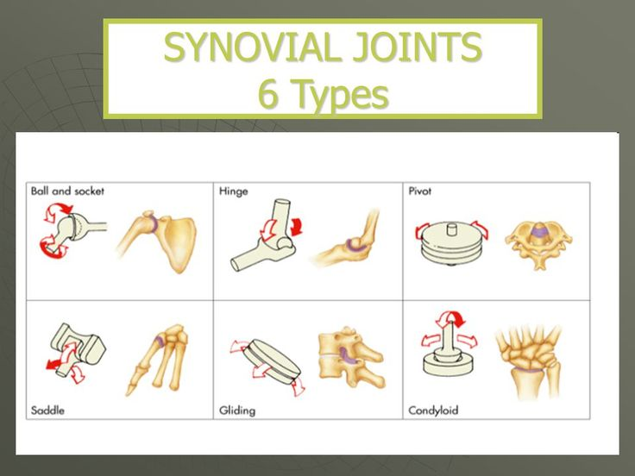

Slide 16
THE CRANIUM
The cranium or skull protects the brain and related structures.
The skull is made up of 22 bones;
8 cranial bones
13 facial bones
The mandible
Cranium
Houses brain
Encloses & protects the brain, provides attachments for muscles, and contains air-filled sinuses that reduce its weight

Slide 17
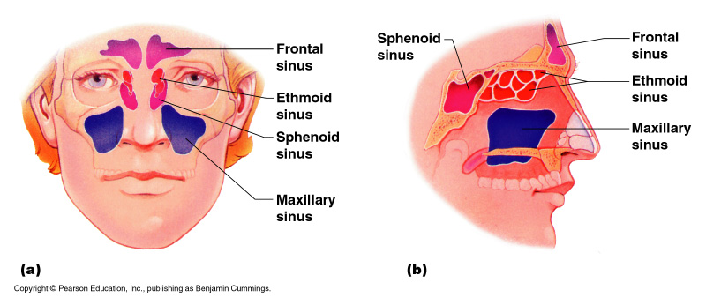
Paranasal Sinuses
Hollow portions of bones surrounding the nasal cavity

Slide 18
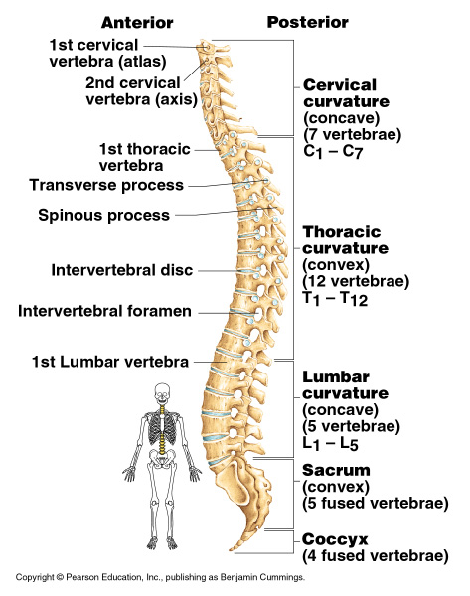
The Vertebral Column
It is a complex structure.
Provides protection for spinal cord.
Also provide mobility and stability of the trunk.
Vertebral column composed 33 vertebrae and 23 intervertebral disks.

Slide 19
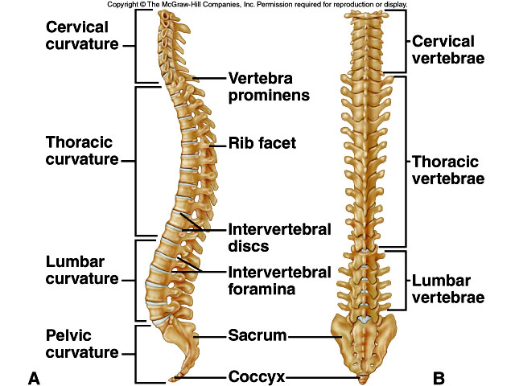

Slide 20
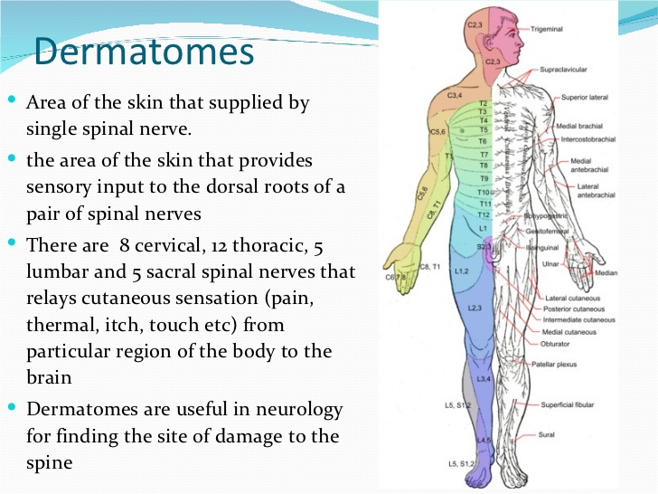

Slide 21
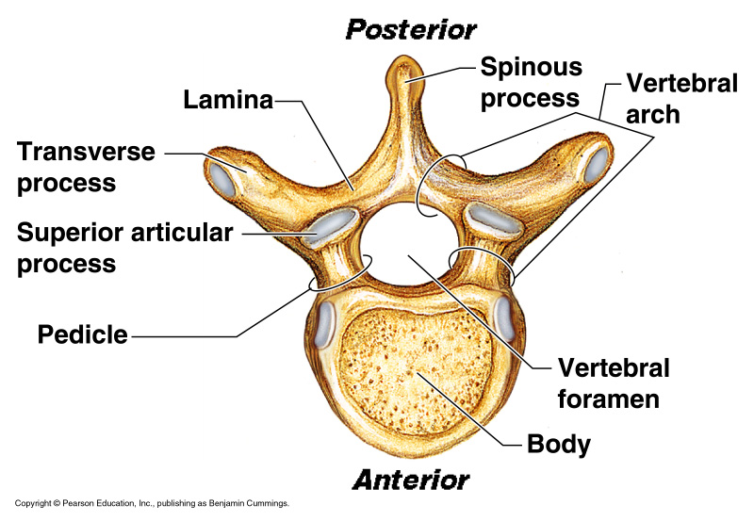
Thoracic cage
ribs
thoracic
Vertebrae
sternum
costal cartilages
True ribs are directly attached to the sternum
(first seven pairs)
Three false ribs are joined to the 7th rib
Two pairs of floating ribs

Slide 22
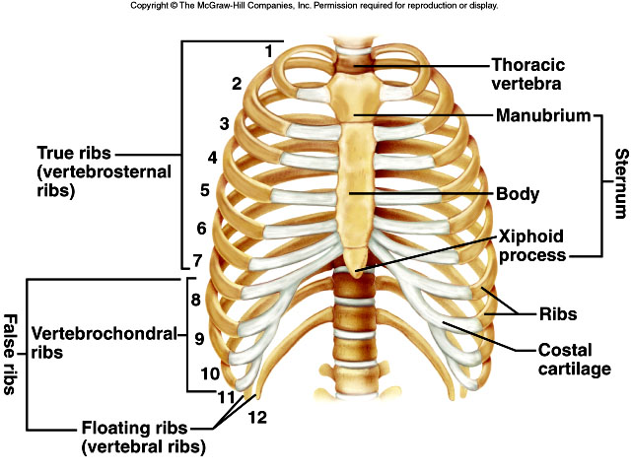

Slide 23
THE THORAX & PELVIS
Heart and lungs are protected by the thorax,which is comprised of the sternum (breastbone),and the thoracic vertebrae.
There are 12 pairs of ribs.
Eacs pair is attached to one of the thoracic vertebra.
The first seven pairs are called the true ribs.
Each of the true ribs is attached to the sternum by a piece of costal cartilage.
The next five is called false ribs, do not attach directly to the sternum.

Slide 24
The pelvis (plural pelves or pelvises) is either the lower part of the trunk of the human body between the abdomen and the thighs (sometimes also called pelvic region of the trunk) or the skeleton embedded in it. (sometimes also called bony pelvis, or pelvic skeleton).
The pelvic region of the trunk includes the bony pelvis, the pelvic cavity (the space enclosed by the bony pelvis), the pelvic floor, below the pelvic cavity, and the perineum, below the pelvic floor.The pelvic skeleton is formed in the area of the back, by the sacrum and the coccyx and anteriorly and to the left and right sides, by a pair of hip bones.

Slide 25
The muscles
Muscles are highly specialized tissue that can contract, or become shorter.
It is important to realize that are two types of movement
-voluntary
-involuntary.
Voluntary movement controlled by conscious thought, such as moving an arm or leg.
Involuntary movement not ordinarily under conscious control.

Slide 26
The are three categories of muscles
-skeletal muscle :- which is voluntary and allows for body movement
-cardiac muscle :- which is involuntary and pump blood through the body
-smooth muscle :- which is involuntary and is found in such structures as the digestive tract and blood vessels.

Slide 27
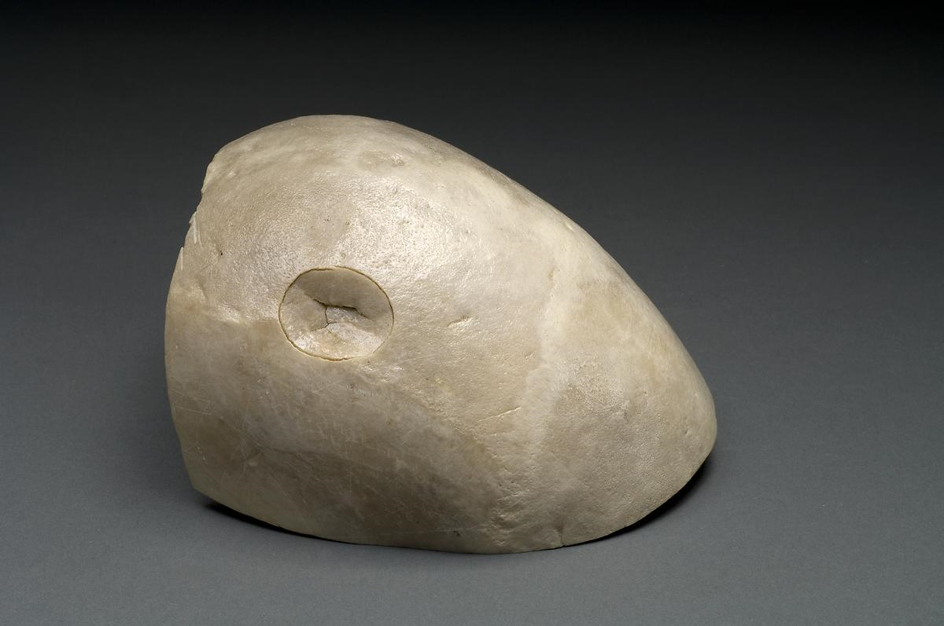
Fractures :

Slide 28
About Fractures:
A bone fracture,is a medical condition where the continuity of the bone is broken.
A significant percentage of bone fractures occur because of high force impact or stress.
a fracture may also be the result of some medical conditions which weaken the bones, for example osteoporosis, some cancers, or osteogenesis imperfecta (also known as brittle bone diseases).
A fracture caused by a medical condition is known as a pathological fracture.

Slide 29
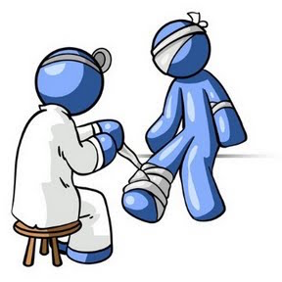
Facts about Fractures:
Most bone fractures are caused by falls and accidents.
Bone fractures caused by disease are referred to as pathological fractures.
A compound fracture is one that also causes injury to the overlying skin.
There are a number of different types of fractures, including avulsion, comminuted, and hairline fractures.
Bone healing is a natural process, treatment revolves around giving the bone optimum conditions to heal itself.

Slide 30
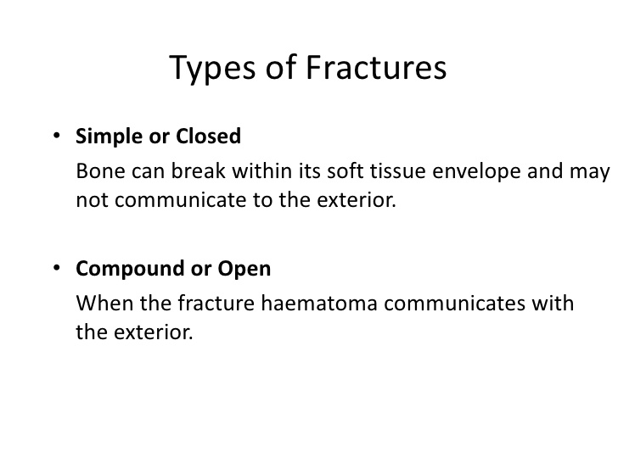

Slide 31
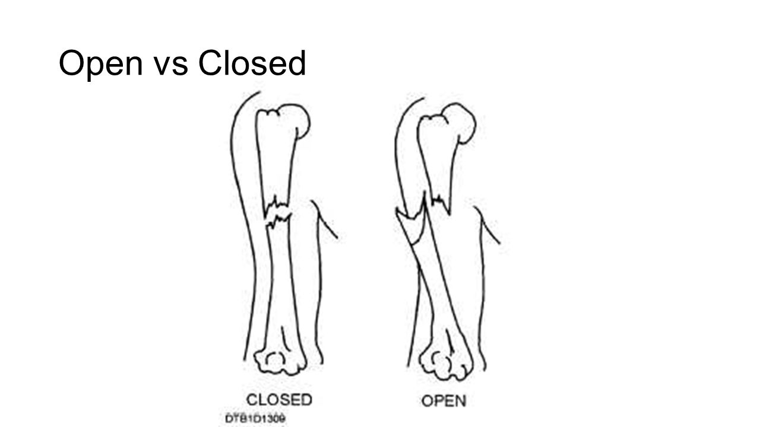

Slide 32
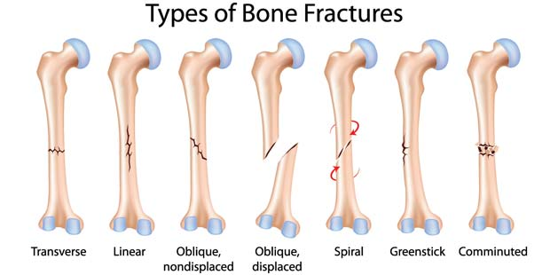

Slide 33
Because of the unique properties of their bones, there are some defined fracture subtypes that present only in children. For example:
A greenstick fracture in which the bone is bent, but not broken all the way through
A buckle fracture results from compression of two bones driven into each other.
A growth plate fracture at the joint that can result in shorter bone length
These fracture subtypes can present in children and adults:
A comminuted fracture is when the bone breaks into several pieces
A transverse fracture is when the fracture line is perpendicular to the shaft (long part) of the bone.
An oblique fracture is when the break is on an angle through the bone
A pathologic fracture is caused by a disease that weakens the bone
A stress fracture is a hairline crack

Slide 34
The severity of a fracture depends upon the fracture subtype and location.
Serious fractures can have dangerous complications if not treated promptly; possible complications include damage to blood vessels or nerves and infection of the bone (osteomyelitis) or surrounding tissue.
Recuperation time varies depending on the age and health of the patient and the type of fracture.
A minor fracture in a child may heal within a few weeks; a serious fracture in an older person may take months to heal.

Slide 35
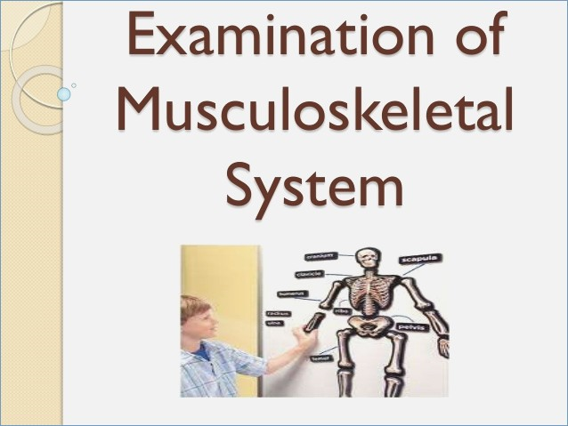

Slide 36
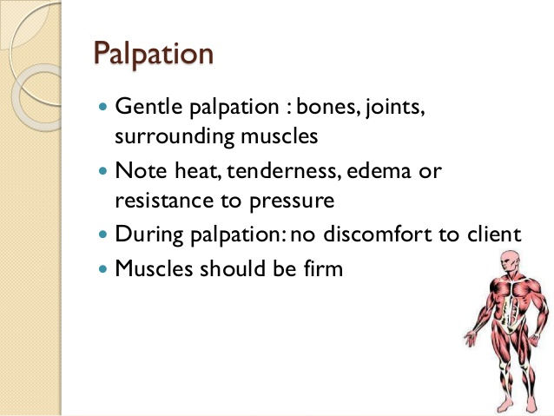

Slide 37
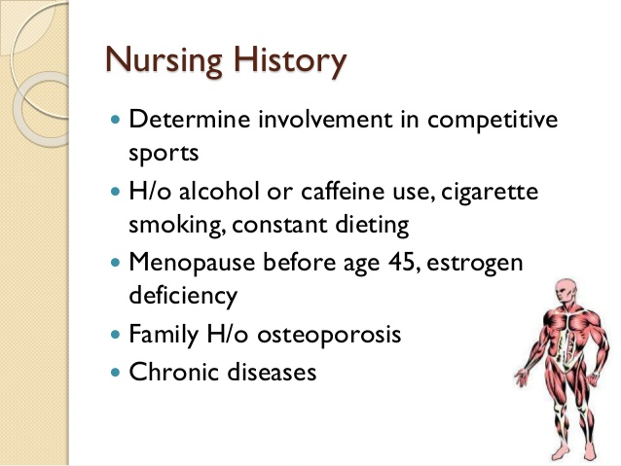

Slide 38
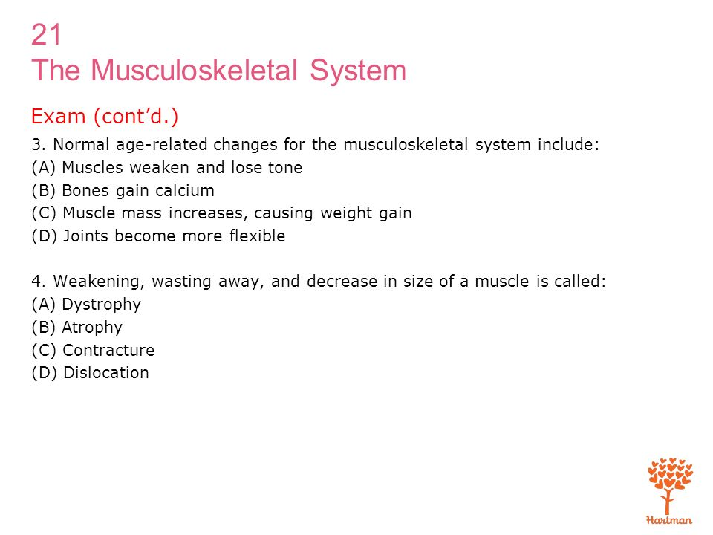

Slide 39
Diseases and Conditions:
Achilles tendinitis-inflammation of the achilles tendon
Ankylosing spondylitis-chronic systemic arthritis involving inflammation and stiffening of the axial skeleton and large peripheral joints
Ankylosis-stiffening or fixation of a joint
Arthralgia-pain in a joint,also called arthrodynia
Arthritis-inflammation of the joints
Arthropathy-any disease that affects the joints
Articular disease-any disease affecting the joints
Avascular necrosis-death of the bone tissue caused by inadequate blood supply
Bunion-type of bursitis that affects the joint at the base of the great toe

Slide 40
Carpal tunnel syndrome-compression of the medial nerve leading to wrist problem
Discoid lupus erythromatoses(DLE)-a chronic disorder of unknown etiology that primarily affects the skin
Ewing tumor-a malignant bone tumor
Fibromyalgia-a group of disorders characterized by aching,tenderness and stiffness of muscles,tendons and adjacent soft tissues
Fracture-any break in the bone or cartilage
Ganglion-a fluid filled cyst most commonly attached to the tendon sheathe in the wrist,hand or foot
Genu varum-deformity of the lower extremity characterised by medial angulation of the leg

Slide 41
Genu valgum-deformity of the lower extremity characterised by lateral angulation of the leg
Gout-metabolic disorder characterised by abnormally high level of uric acid in the blood
Herniated intervertebral disk-a rupture all or part of the gelatinous central portion of the disk is forced through a weakenend outer portion of the disk
Infectious arthritis-inflammation of the joints caused by bacterial,fungal or viral infection
Kyphosis-forward leaning
Lordosis-backward leaning
Lyme disease-recurrent inflammatory disorder caused by bacteria

Slide 42
Metatarsalgia-pain in the metatarsals
Multiple myeloma-malignant bone tumor involving plasma producig cellsin bone marrow
Osteoarthritis-degenerative disorder characterised by erosion of articular cartilage and hypertrophy of bone
Osteochondroma-common benign tumor
Osteomyelitis-inflammation and destruction of bone and bone marrow caused by bacterial or fungal infections
Osteoporosis-progressive loss of bone density
Osteosarcoma-malignant bone tumor
Paget disease of bone-chronic adult disorder in which hyperactive bone reabsorption results in thichened and softened areas of localized bones

Slide 43
Polychondritis-episodic inflammatory condition that destroys cartilage connective tissues
Polymyalgia rheumatica-muscle condition characterised by severe pain and stiffness in proximal muscle groups
Polymyositis-systemic connective tissue disease characterised by inflammation and atrophy of the muscles
Posterior femoral muscle strain-muscle strain causing acute pain in the posterior thigh
Rheumatoid arthritis-chronic inflammation of the periferal joints leading to destruction
Rickets-childhood disease caused by deficiency of vitamin D
Scoliosis-abnormal lateral curvature of spine

Slide 44
Shin splint-tenderness and pain in the anterior muscles of the lower leg
Sjogren syndrome-chronic inflammatory disorder associated with rheumatoid arthritis
Spondylitis-inflammation of one or more vertebrae
Spur-abnormal bone formation at the edges of the joint
Strain-injury to connective tissue usually muscles caused by overuse or improper use
Swelling around joints-enlargement around a joint caused by excessive accumulation of fluids
Systemic lupus erythematosus-chronic inflammatory disease of connective tissue

Slide 45
Talipes-any deformity of the foot that involves the talus
Tendonitis-inflammation of the tendon

Slide 46
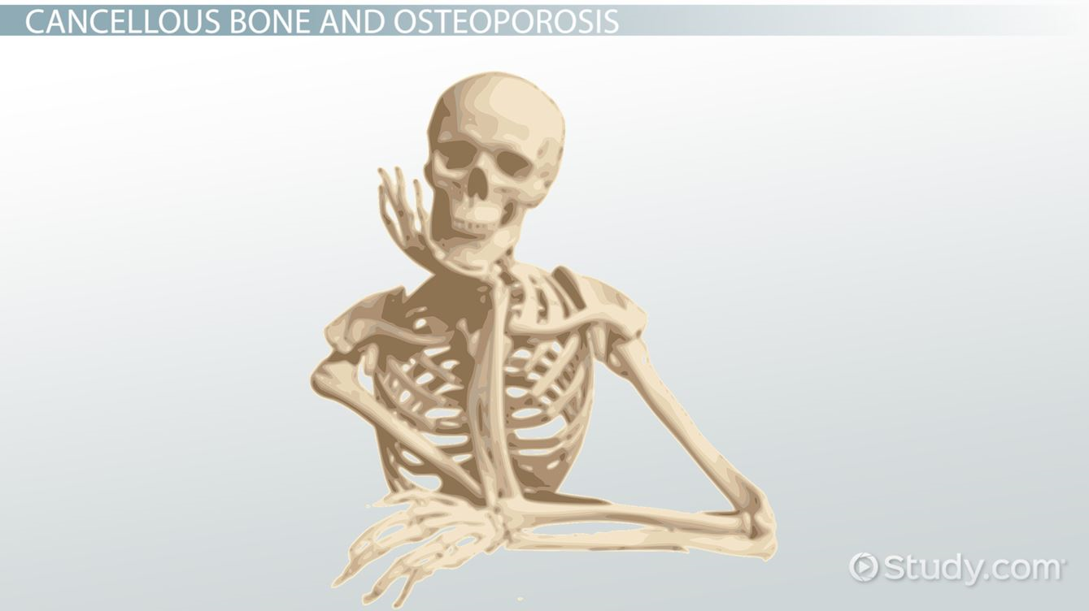
THANK YOU

